Slide 1
HRSA Flex EMS Supplemental Grant Project
March 23, 2023
NEMSQA Learning Session 4

Slide 2
Objectives
The First Objective
Michigan EMS data flow
The Second Objective
Understand the last 2 measures: Trauma 01 and Trauma 03
The Third Objective
Review and discuss EMS raw data.

Slide 3
Data Flow
States and software companies create products that are used to send and receive EMS data in the proper XML format from agencies to states, then on to the National EMS Database.
Local Agencies select elements according to their needs—keeping the national elements AND state elements as part of their selected elements.
2. States select elements from the NEMSIS Dataset according to their needs—keeping the national elements as part of their selection.
3. The national elements are transmitted to the NEMSIS TAC to populate the National EMS Dataset.

Slide 4
Learning Session 4 NEMSQA Measures
Trauma 01 measure criteria
Percentage of EMS responses originating from a 911, intercept, or mutual aid request for patients with injury who were assessed for pain.
Numerator/Denominator (refer to NEMSQA definitions)
NEMSIS documentation area: vitals
Trauma 03 measure criteria
Percentage of EMS transports originating from a 911, intercept, or mutual aid request for patients whose pain score was lowered during the EMS encounter
Numerator/Denominator (refer to NEMSQA definitions)
NEMSIS documentation area: vitals

Slide 5
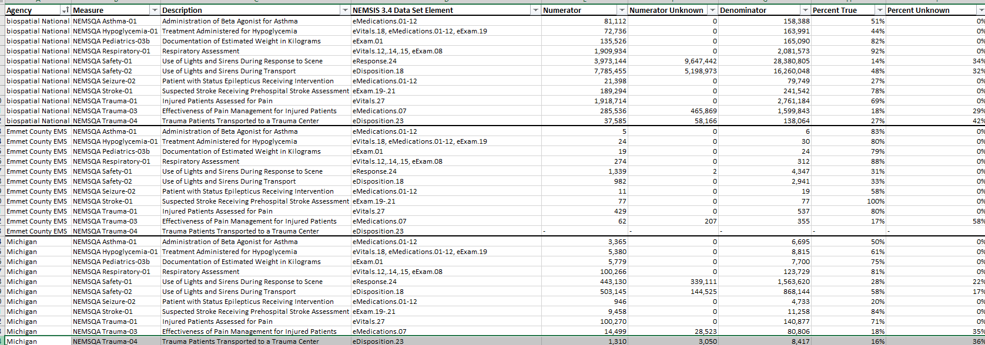
Your EMS Data

Slide 6
Your EMS Data
Service level

Slide 7
Let’s Review
What does the percent true signify?
What does the percent unknown signify?
What does the NEMSIS data element signify?
How can these metrics be impacted by your level of service, call volume, etc.?

Slide 8
The Impact of Clinical Documentation
Clinical field documentation matters.
Let’s look at a few EPCR examples in our software vendors:
ESO
Elite
Our focus:
NEMSQA Trauma 01
NEMSQA Trauma 03

Slide 9
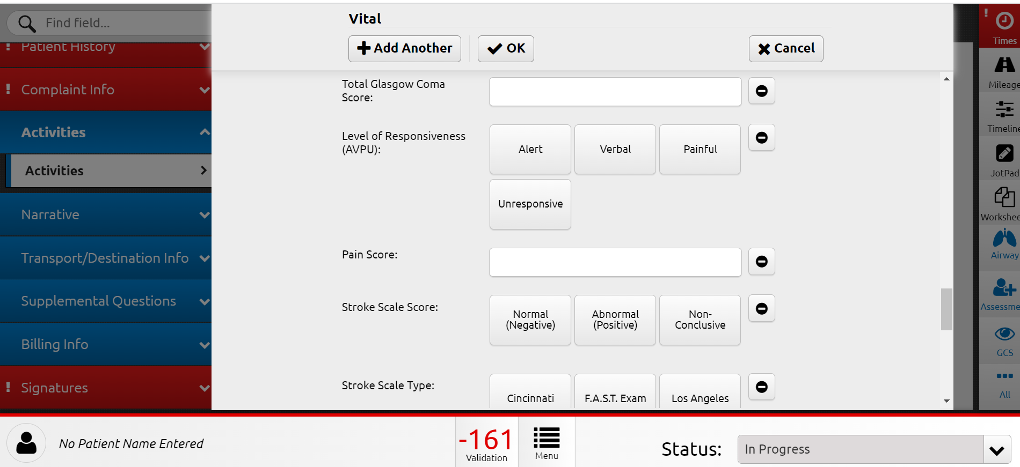
Elite: Trauma 01 and Trauma 03 Pain

Slide 10
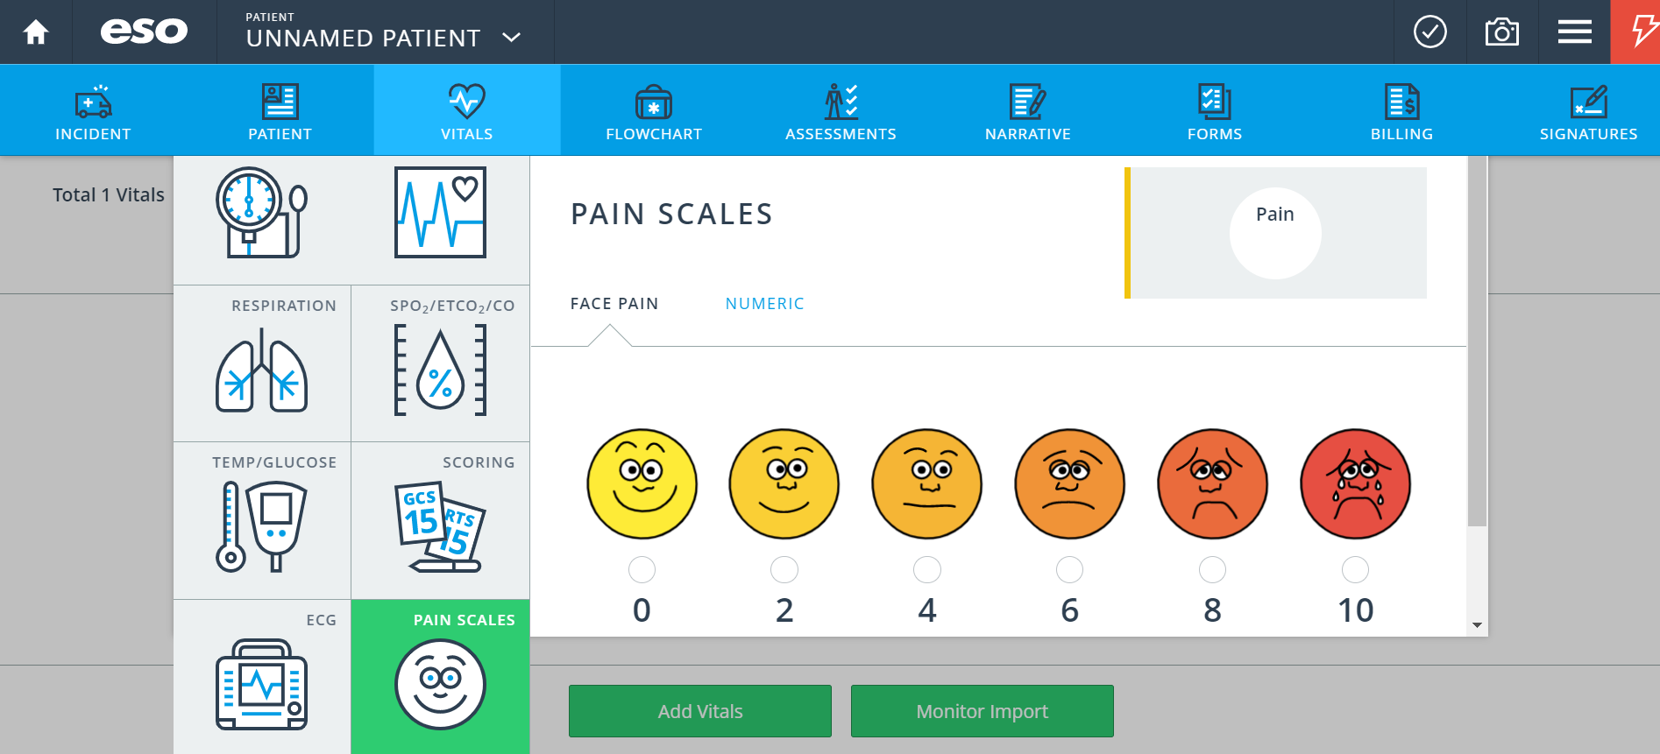
ESO: Trauma 01 and Trauma 03 Pain

Slide 11
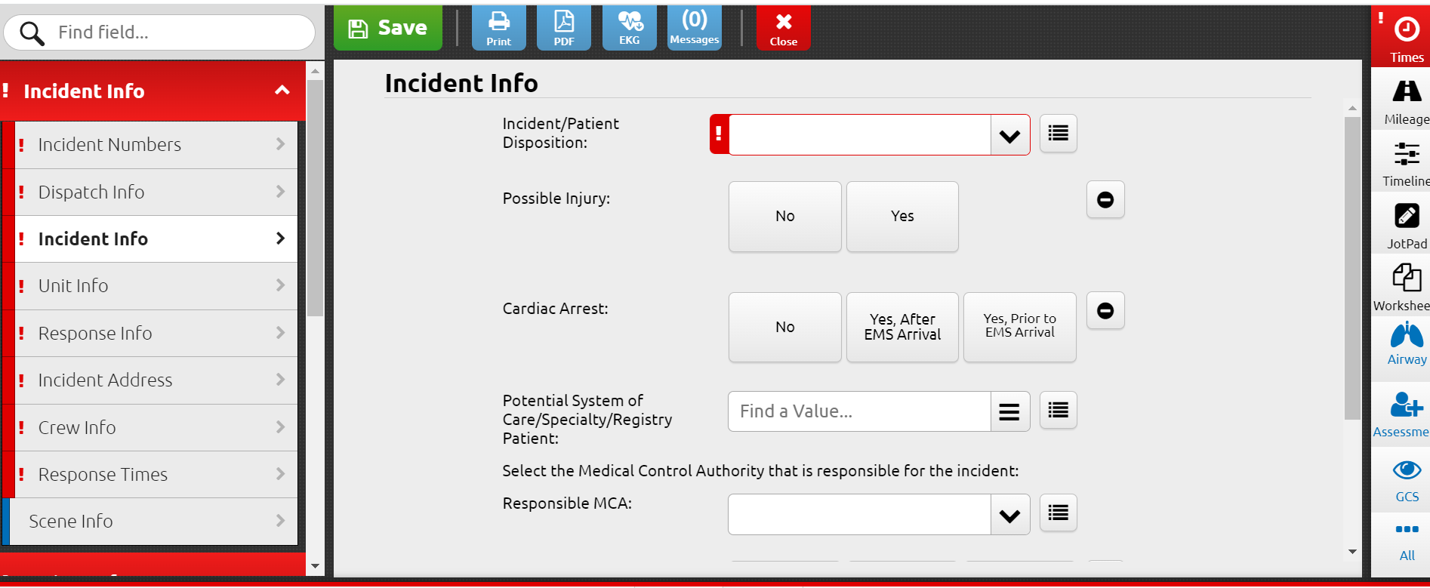
Elite: Trauma 01 and Trauma 03 Injury

Slide 12
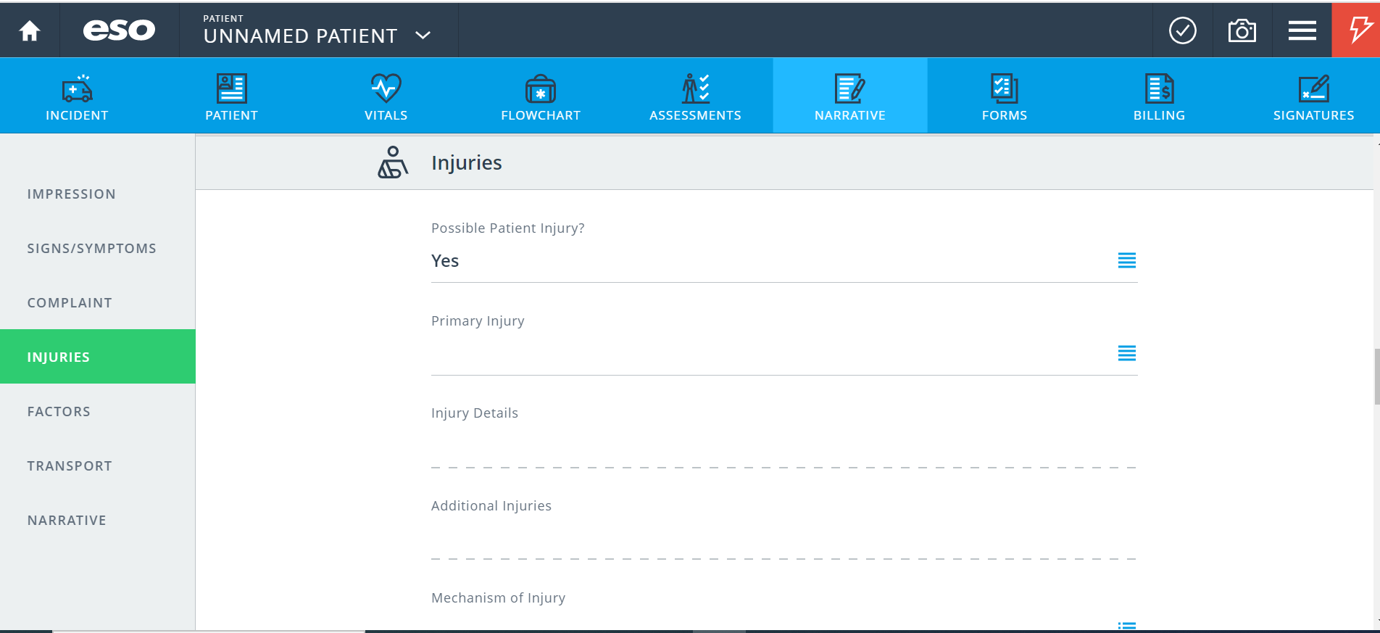
ESO: Trauma 01 and Trauma 03 Injury

Slide 13
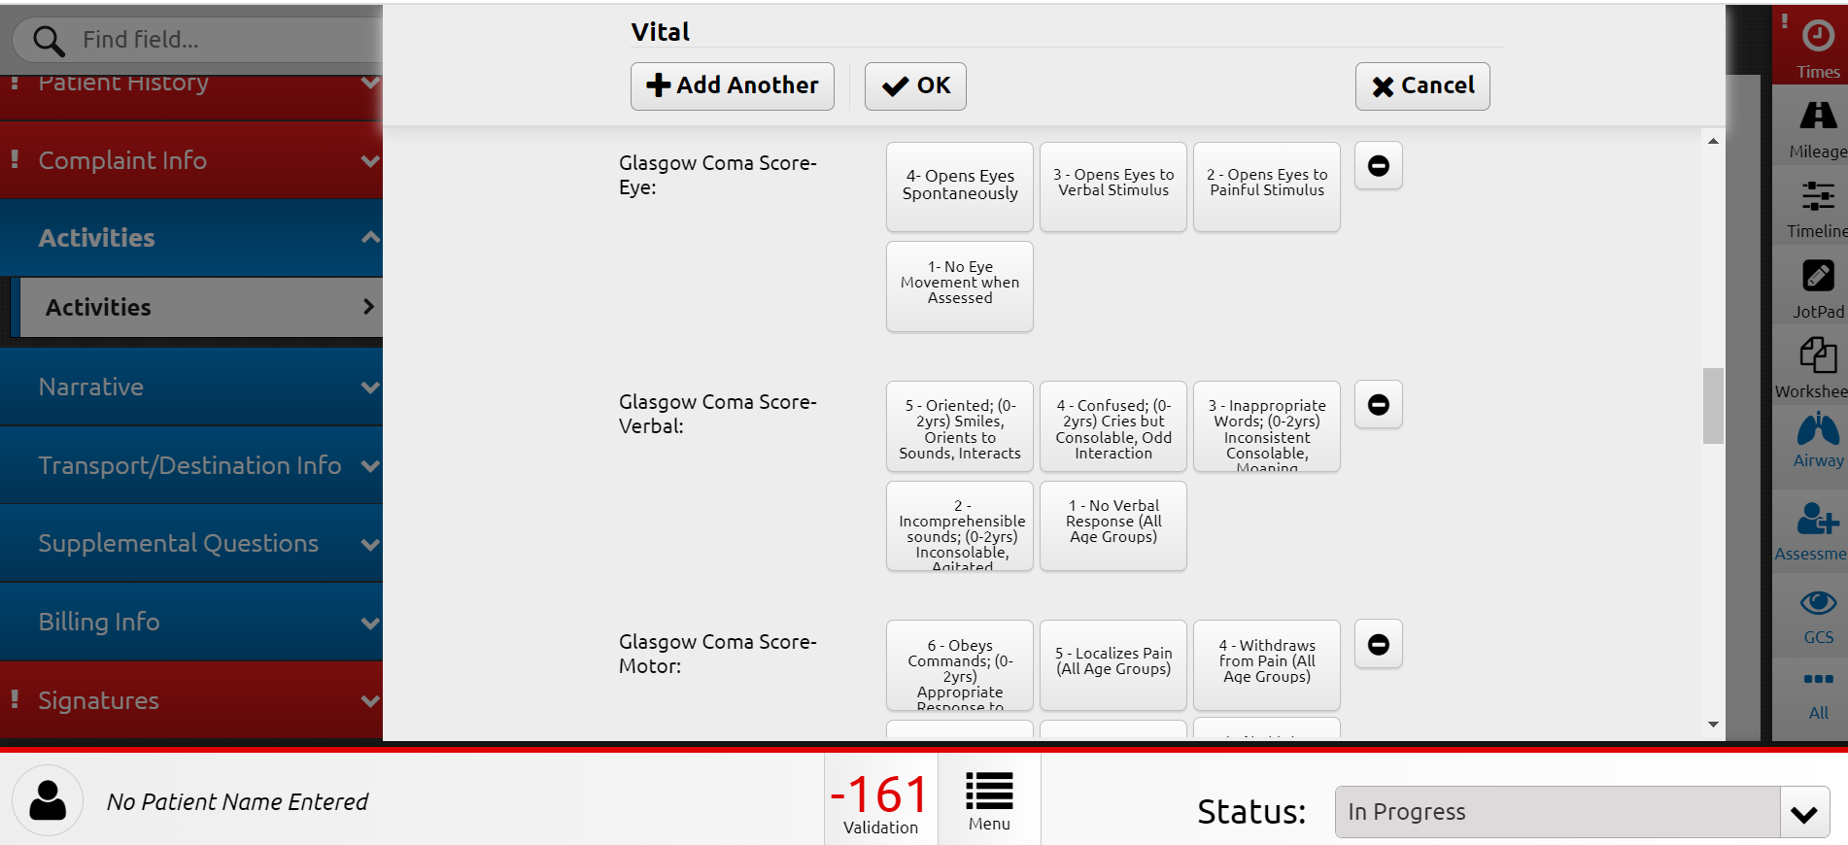
Elite: Trauma 01 and Trauma 03 GCS

Slide 14
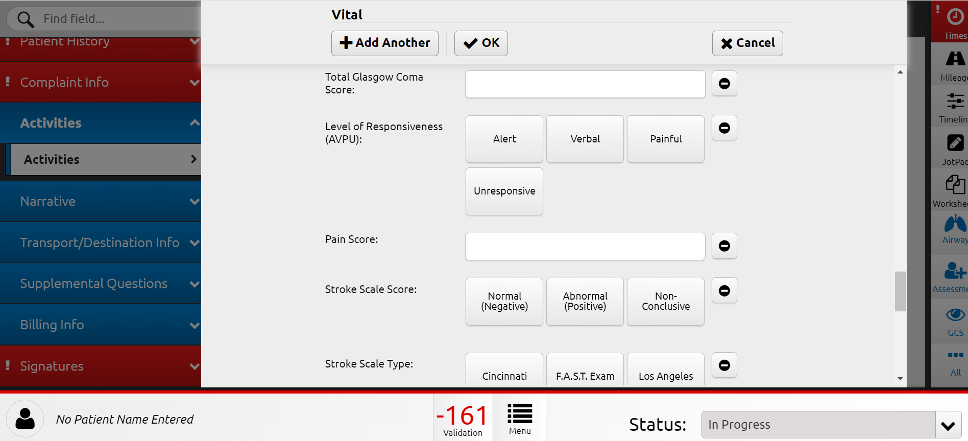
Elite: Trauma 01 and Trauma 03 AVPU

Slide 15
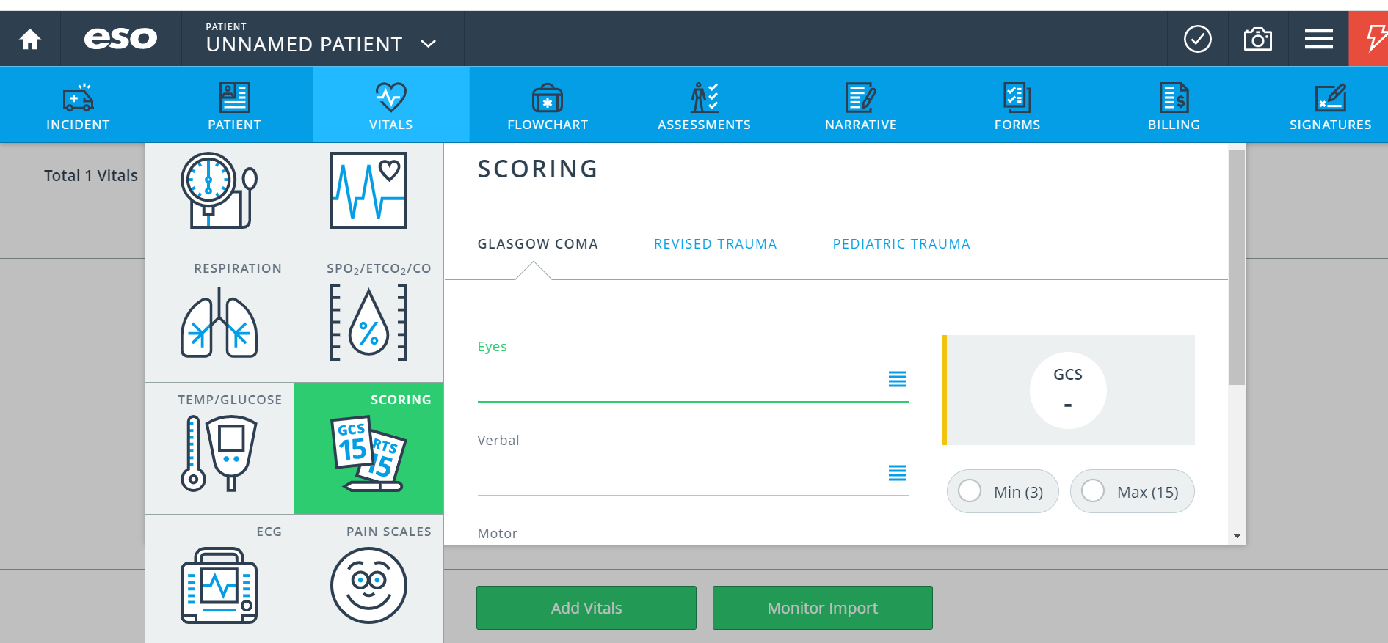
ESO: Trauma 01 and Trauma 03 GCS

Slide 16
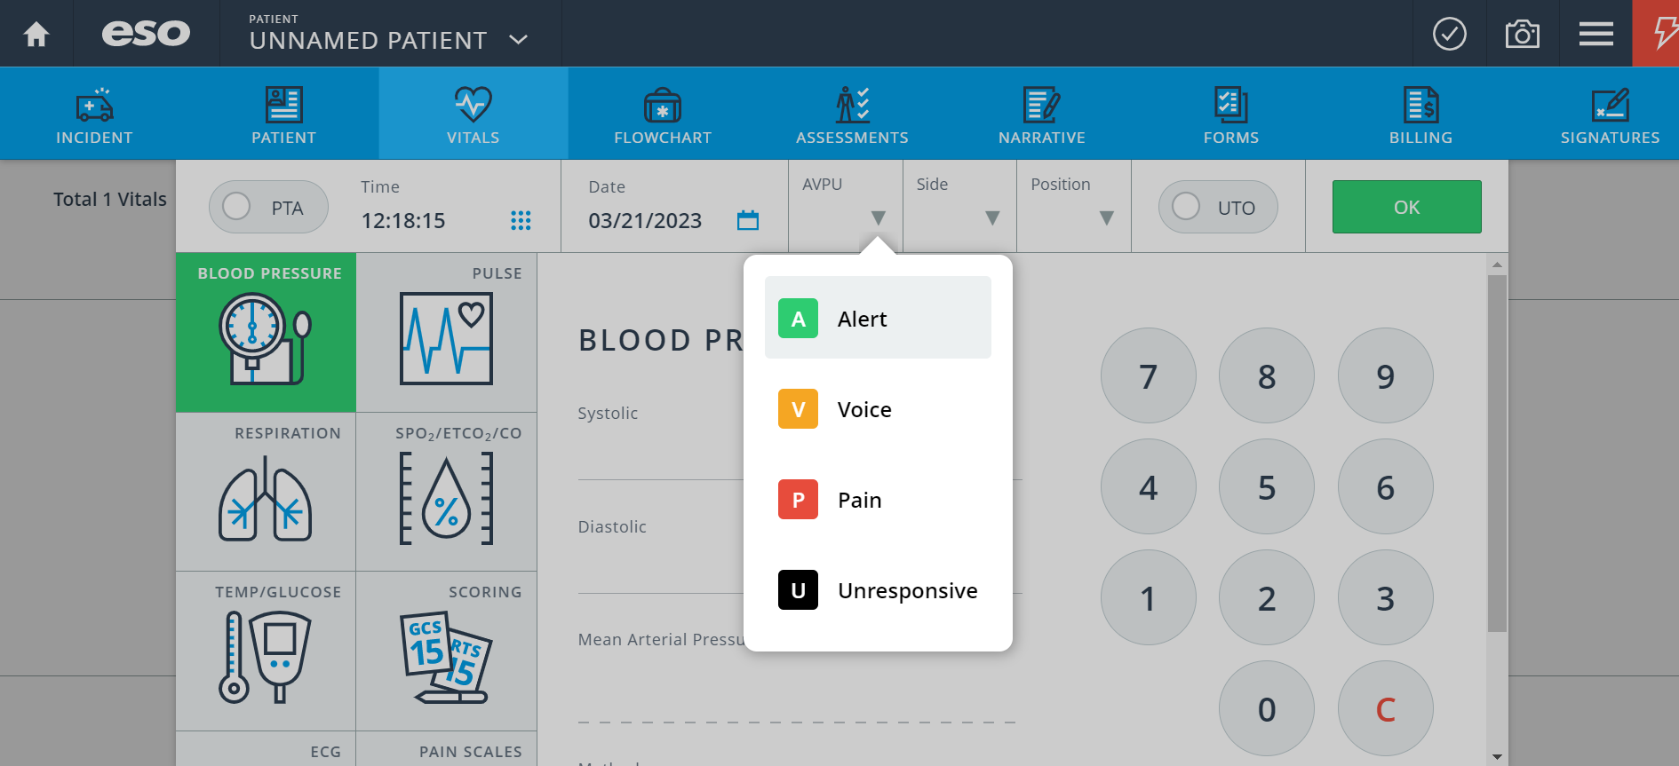
ESO: Trauma 01 and Trauma 03 AVPU

Slide 17
Let’s Review
What are the similarities and differences between the trauma 01 and trauma 03 NEMSQA measure?
Is this a BLS or ALS service level measurement?

Slide 18
Conclusion
How can we improve the gaps in our data reporting?
Identify the data gap (s)
Discover what's causing the gap
Implement the solution over time

Slide 19
01
Michigan NEMSIS
https://nemsis.org/state-data-managers/state-map-v3/michigan/
References
02
NEMSQA
https://www.nemsqa.org/nemsqa-measures
04
ESO EHR
05
Image Trend Elite

Slide 20
Thank you!
Do you have any questions for us?

