Slide 1


HRSA Flex EMS Supplemental Grant Project
January 12, 2023
NEMSQA Learning Session 1

Slide 2
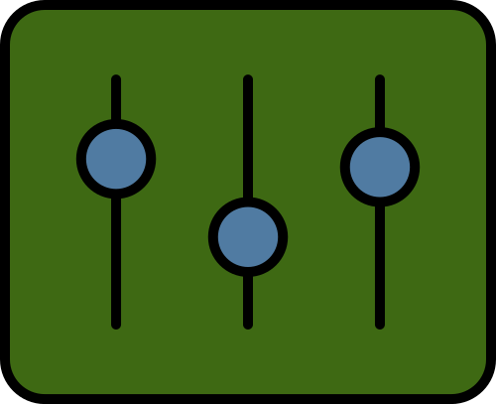


Objectives
The First Objective
Understand NEMSIS and how EMS data flows
The Second Objective
Understand NEMSQA and identify the approved 11 measures
The Third Objective
Understand EMS agency baseline data around our first 3 NEMSQA project meaures

Slide 3

Introduction to NEMSIS
The National Emergency Medical Services Information Systems is used to store data EMS data from states and territories.
NEMSIS is a national standard for storing patient care information for 911 systems.
NEMSIS is a product of NHTSA’s Office of EMS and in collaboration with the University of Utah is the host of the Technical Assistance Center (TAC).

Slide 4

Data Flow
States and software companies create products that are used to send and receive EMS data in the proper XML format from agencies to states, then on to the National EMS Database.
  Local Agencies select elements according to their needs—keeping the national elements AND state elements as part of their selected elements.
2. States select elements from the NEMSIS Dataset according to their needs—keeping the national elements as part of their selection.
3. The national elements are transmitted to the NEMSIS TAC to populate the National EMS Dataset.

Slide 5
The Impact of Clinical Documentation
Clinical field documentation matters.
Clinical documentation fields, close call rules, data mapping and what the provider documents impacts data reporting locally and nationally.
Our cohort: uses ESO, Image Trend and Sryker software vendors.

Slide 6

NEMSQA
  The National EMS Quality Alliance has researched and developed 11 approved measures.
  Each measure has been researched, tested and exposed to public comment before approval.
  We will focus on the first 3 measures today:
    hypoglycemia 01
    respiratory 01
    asthma 01

Slide 7

NEMSQA Measures
Let's review the numerator & denominator together
  Hypoglycemia 01 measure criteria
Numerator/Denominator
  Respiratory 01 measure criteria
Numerator/Denominator
  Asthma 01 measure criteria
Numerator/Denominator
Let's tie these measures to our data

Slide 8
Your EMS Data

Slide 9
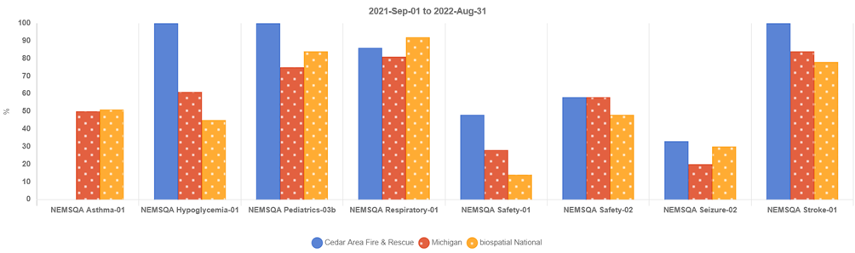

Your EMS Data

Slide 10

Conclusion
Now that we have a basic understanding of NEMSIS, NEMSQA and how our data flows, we can begin to investigate our own data.
How can we improve the gaps in our data reporting?
  Identify the data gap (s)
  Discover what's causing the gap
  Implement the solution over time

Slide 11

References
01
Michigan NEMSIS
https://nemsis.org/state-data-managers/state-map-v3/michigan/
02
NEMSQA
https://www.nemsqa.org/nemsqa-measures

Slide 12

Thank you!
Do you have any questions for us?

